Slide 2
Automate Business Processes – Logic Apps Deep Dive
AZR312
Kevin Lam
Jeff Hollan
Program Manager
#TR23AZR312

Slide 3
Confidentiality slide

Slide 4
Q&A
If you have questions please proceed to the Q&A MICROPHONE located in your session room.

Slide 5
Session objectives and takeaways
Session objective(s):
Automate business processes to orchestrate across services and protocols
Integrate with services from on-premises to the cloud
Provide simple manageability
Logic Apps is Microsoft’s key strategy for integration and orchestration in the cloud

Slide 6

Agenda
Enterprise Integration in Azure
Concepts
Demo: Building a Logic App
Language
Management
Demo: Request/Response & hybrid integration
Demo: Monitoring & ALM
Enterprise Integration
Demo: Integration Accounts & B2B
Pricing

Slide 7






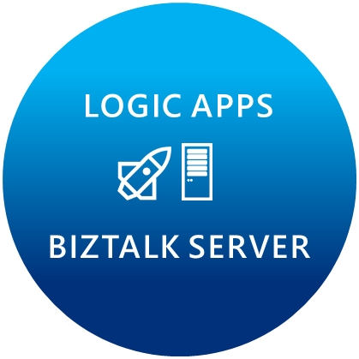











Microsoft’s Enterprise integration vision
LOGIC APPS
BIZTALK SERVER
About 39% of developers are focused on building cloud based Application integration
API MANAGEMENT
AZURE SERVICE BUS
IoT/Event Hub
Azure Search
SQL Database
CONNECTORS
AZURE SERVICES
AZURE SERVICE BUS
DocDB
BLOB Storage
Functions
API MANAGMENT
Azure ML
HD Insight
Site Recovery
B2B/EDI
Tables
Search
DNS

Slide 8
Automate business processes in the cloud with Logic Apps
Create business processes and workflows visually
Integrate with SaaS and enterprise applications
Unlock value across on-premises and cloud
Automate EAI, B2B/EDI, and business processes
Leverage Integration Platform as a Service (iPaaS)

Slide 9
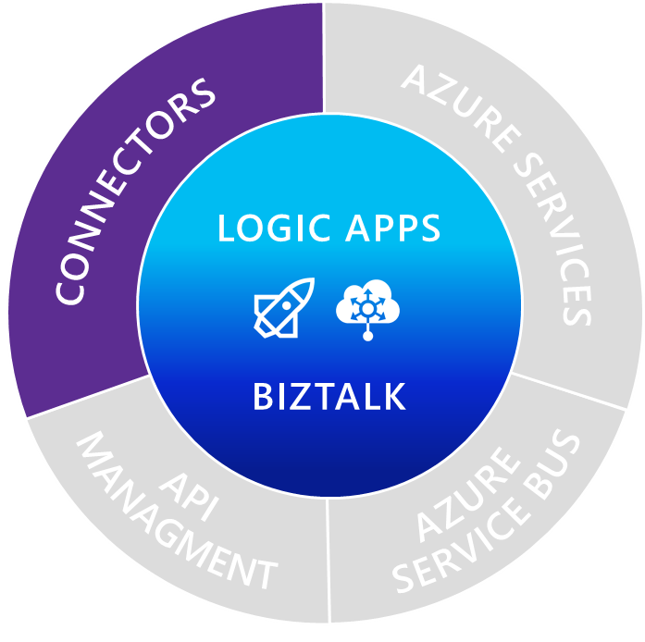
Managed connectors
Cloud APIs and platform functionality
Dozens of built-in connectors
Hosted and managed within the platform
Scales to meet your needs
First class designer experience
Rapid development
LOGIC APPS
BIZTALK
API connections
Authenticate once and reuse
Differentiate connection configuration
Simple to deploy
Portal experience for managing API Connections

Slide 10
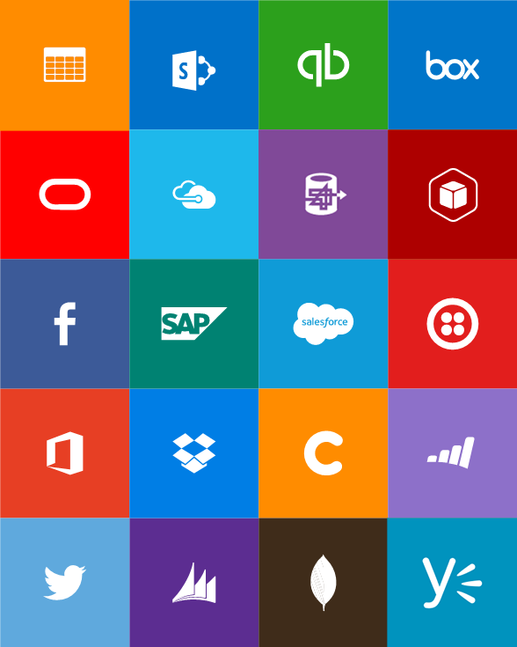
Out-of-box connectors
SaaS
Azure Service Bus
Azure Storage Blob
Bing Search
Box
Dropbox
Dynamics CRM Online
Facebook
GitHub
Google Calendar
Google Drive
Google Sheets
Google Tasks
Instagram
MailChimp
Mandrill
Microsoft Project Online
Microsoft Translator
Office 365
Office 365 Users
OneDrive
OneDrive for Business
Outlook.com
Project Online
Salesforce
SendGrid
SharePoint Online
Slack
SparkPost
SQL Azure
Trello
Twilio
Twitter
Wunderlist
Yammer
YouTube
Protocols
Enterprise messaging
Hybrid
HTTP, HTTPS
HTTP Webhook
FTP, SFTP
SMTP
RSS
Delay
Workflow
Validate
Transform (+Mapper)
Convert (XML-FF)
X12
AS2
SQL Server

Slide 11
Upcoming connectors
SaaS
Hybrid
DocuSign
Google Mail
Lithium
OneNote
Stripe
Bing Search
UserVoice
Trello
VSTS
ZenDesk
IBM DB2
Informix
SharePoint Server
Oracle DB
File
Websphere MQ
SAP
Oracle EBS
CICS
Enterprise messaging
EDIFACT
Party resolution

Slide 12
Custom and External APIs
Any reachable Web API
Auto discovery of Azure hosted APIs
Has ApiDefinition (swagger)
Declaratively reference an external API
HTTP + Swagger
HTTP action for any other endpoint

Slide 13
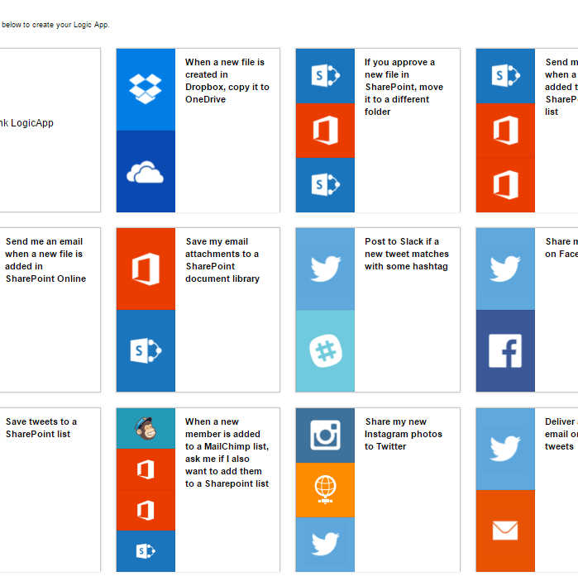
Templates
Get started quickly
Ideas for new integrations
Understand usage patterns

Slide 14
Demo: Create a Logic App

Slide 15
Control Flow

Slide 16
Triggering a Logic App “Run”
Recurring schedule – “every X hours”
Polling an API for a response A 200 response means “run” – a 202 response means “wait” Can use trigger state to get information on the previous execution
Manual Webhook Every workflow has an endpoint you can POST to from and web service using a SAS URL
Webhook subscription Subscribe to a web services webhook
On Demand User can click the “Run Now” button in the portal

Slide 17
Actions can…
Call out
API Apps, Direct HTTP endpoints, Other Workflows, send a response
Honor asynchronous pattern
Continues on 202 status code
Follows location header
Waits for retry after interval
Wait for events
Wait for a period of time
Wait for a Webhook to be called
Be a scope
Conditions determine whether the action should execute
For each executes an action for each item in a collection
Do-while will continually execute an action until a condition is met
Have custom retry policy
By default retries 4 times separated by 20 seconds

Slide 18
Response
Send a response to a manual trigger or webhook
Replaces need for HTTP Listener connector
Constraints:
Cannot be in parallel
Cannot respond to a trigger that uses splitOn

Slide 19
SplitOn
Debatch an array of input items
Runs N instances of the logic app
Retrieve run status for each logic app
"triggers": {
"manual": {
"type": "manual",
"inputs": {},
"spliton": "@triggerbody().value"
}
}

Slide 20
Retry
Every action has a default retry of 4 times every 20 seconds
Configurable up to 4 retries of 1 hour each
Option to disable retries

Slide 21
Scopes
Encapsulates a set of actions
Can be used for error handling and compensation
Access results of each action in the scope:
@result(<scopeName>)[index]

Slide 22
Conditionals
If .. Else Boolean expression
Can have nested conditions

Slide 23
Iterating over a list
Loop a single action over a list of items
Runs the action N times
You can get at all of the statuses for each action

Slide 24
Do…until
Loop a single action based on a condition
Runs the action repeatedly until it evaluated to true
Define a limit either by:
Amount of time (e.g. for 1 hour)
Total number of iterations
The overall action has status/outputs but not the individual iterations

Slide 25
Workflow Definition Language

Slide 26
Logic Apps workflow definition concepts
{
"parameters": {
...
},
"triggers": {
...
},
"actions": {
...
},
"outputs": {
...
}
}

Slide 27
Parameters
Re-using values, or even complex objects, throughout the definition, which makes it easier to comprehend.
Separate out config from the definition itself, making sharing easy, as well as across different environments.
"parameters": {
"<parameterName>": {
"type": "<type-of-parameter-value>",
"defaultValue": "<optional-default-value-of-parameter>",
"allowedValues": [ "<optional-array-of-allowed-values>" ]
}
}

Slide 28
Parameters
Re-using values, or even complex objects, throughout the definition, which makes it easier to comprehend.
Separate out config from the definition itself, making sharing easy, as well as across different environments.
DEV WORKFLOW
PROD WORKFLOW
Parameters
Provides DEV configuration
Endpoint: “http://int.mysite.net”
Definition
Declares parameters
Uri: @parameters (‘endpoint’)
Parameters
Provides PROD configuration
Endpoint: “http://mysite.net”
Definition
(identical)
Declares parameters
Uri: @parameters (‘endpoint’)

Slide 29
Triggers
"<name-of-the-trigger>": {
"type": “Request|Http|ApiConnection|HTTPWebhook|ApiConnectionWebhook|Recurrence",
"inputs": { "<trigger-specific-inputs>" },
"recurrence": {
"frequency": "Second|Minute|Hour|Day|Week|Month|Year",
"interval": "<recurrence interval in units of frequency>"
},
"splitOn": "<array>",
"conditions": [ "<array-of-post-conditions>" ]
}

Slide 30
Actions
"<name-of-the-action>": {
"type": "Http|ApiConnection|ApiConnectionWebhook|Response|Wait|Workflow |If|Foreach|Until|Scope",
"inputs": { "<action-specific-inputs and retry policy>" },
“runAfter": {"<reference-to-action-status-to-run-after>“},
“operationOptions": "<list-of-any-operation-flags>"
}

Slide 31
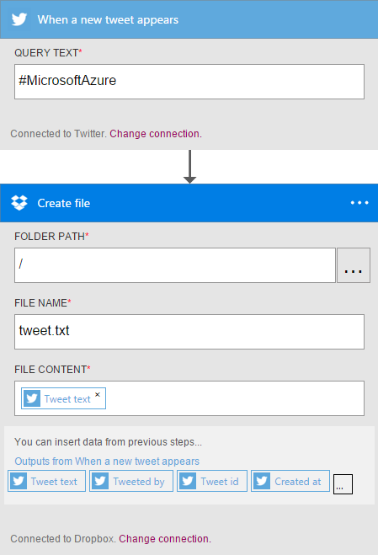
Actions with simple orchestration
Explicit “runAfter” – you can mark certain actions to run only after previous ones have completed “runAfter”: {“When_a_new_tweet_appears”:[“Succeeded”]}

Slide 32
Workflow Definition Functions
@guid() – generate a GUID
@utcnow(‘yyyy-mm-dd’) – generate a date/time
@json() – convert to application/json – can parse like JSON
@xml() – convert to application/xml
@xpath(<xml>, <expression>) – execute Xpath expression
@string() – convert to plain/text
@if(<condition>, <true>, <false>) – set value based on condition
@result(<scope>) – return the run result for a scope of actions

Slide 33
Management

Slide 34
Debugging and History
Trigger history shows polling results
Run history shows details for each logic app run
Monitoring view shows step by step results
Diagnostics & Alerts
Azure

Slide 35

Logic Apps tools for Visual Studio
Logic Apps designer hosted in Visual Studio
Using deployment templates as persistence file
Application Lifecycle Management
CI/CD

Slide 36

Best practices
Use your normal source control system to manage the workflow definition
Separate out config from the definition using parameters
Do not use the portal to modify the definitions directly, that will break sync with your source control

Slide 37




Logic Apps Hybrid Integration
Azure Logic Apps
On-premises data gateway
SQL

Slide 38
Demo: Request / Response & Hybrid integration

Slide 39
Demo: Monitoring & ALM

Slide 40
Enterprise Integration

Slide 41
Enterprise Integration Pack
Connectors for protocols, SaaS, Enterprise systems
Format Conversion (XML, JSON, FlatFile)
Validation
Extract
Transform
Batching/Debatching
Business Rules
Trading Partner Management
B2B - AS2/X12/EDIFACT
Integration Account

Slide 42
Integration Account
Artifact store for messaging resources
XML Schemas
XSLT Maps
Support large files
Trading Partner Management
Partners
Agreements
Metadata extensions
First class Azure resource
Participate in deployment templates
SDK for managing integration entities
Portal experience

Slide 43
Demo: Integration Account & EDI message Processing

Slide 44
Pricing
Consumption Pricing
Action executions
ASP not required but supported (throttled)

Slide 45
When is GA?
July 27th

Slide 46
In review: session objectives and takeaways
Session objective(s):
Automate business processes to orchestrate across services and protocols
Integrate with services from on-premises to the cloud
Provide simple manageability
Logic Apps is Microsoft’s key strategy for integration and orchestration in the cloud

Slide 47
Related content
TechReady Breakout Sessions
AZR301 Delivering solutions using new Azure and on-premises connectors for heritage IBM systems
AZR309 Using Azure Functions and WebJobs in modern & serverless applications
ARC212 The API Economy – What Can We Learn from Azure API Management Customers?
AZR200 All you need to know about Azure API Management to look smart in front of customers
AZR319 Azure API Apps: Exposed, Explained, and Exemplified
TechReady Prerecorded Sessions
DEVTT205 Microsoft Integration – Logic Apps and BizTalk

Slide 48
Q&A
If you have questions please proceed to the Q&A MICROPHONE located in your session room.

